Slide 1
NORMALIZATION
Normalization is the process of reorganizing data in a database so that it meets two basic requirements: There is no redundancy of data, all data is stored in only one place.
Normalization rules divides larger tables into smaller tables and links them using relationships. The purpose of Normalization in SQL is to eliminate redundant (repetitive) data and ensure data is stored logically.

Slide 2
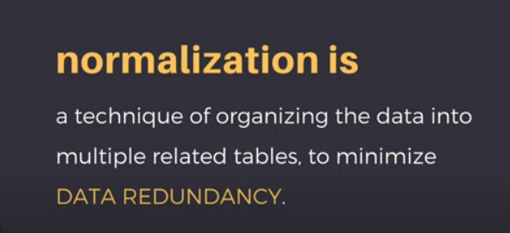

Slide 3
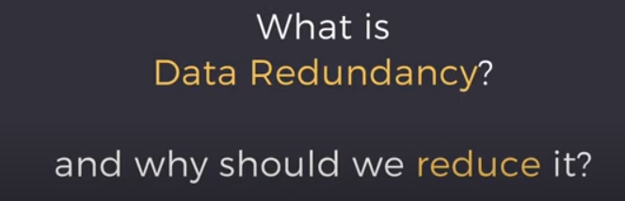
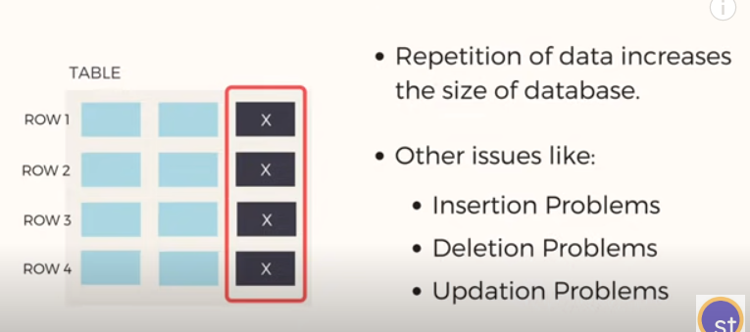

Slide 4
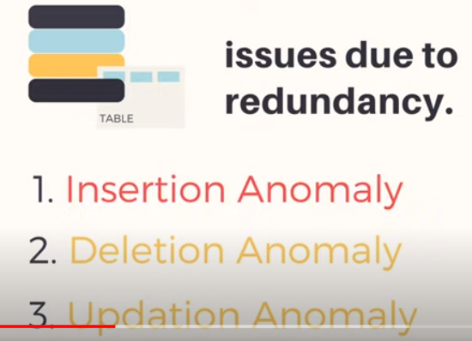

Slide 5
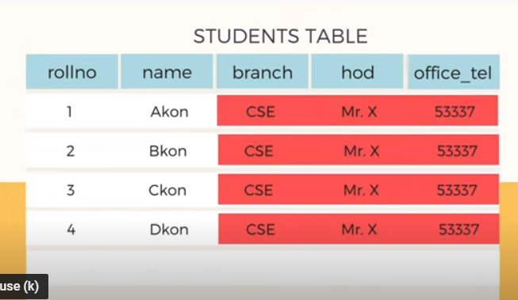
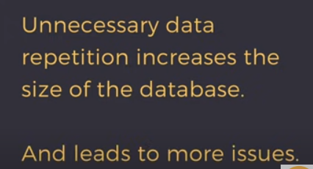
Insertion anomaly
Whenever new student data is inserted branch,hod ,office_tel this data is repeated again which is waste of storage

Slide 6
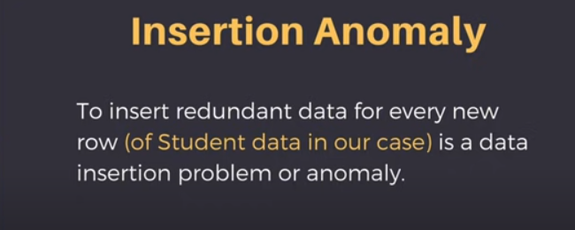
Suppose we are adding the 100 students record then branch,hod ,office_tel this data is repeated again and agian

Slide 7
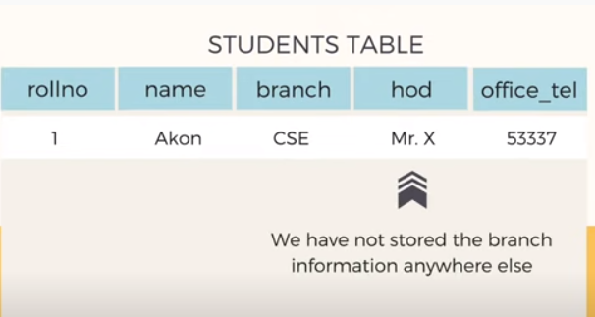
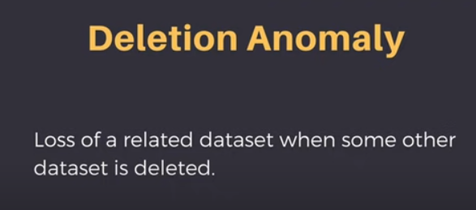
Deletion anomaly
Suppose we delete any student data then branch information is also deleted and when last data is also deleted then branch information is also deleted ,so because of this we deleted student data as well branch information

Slide 8
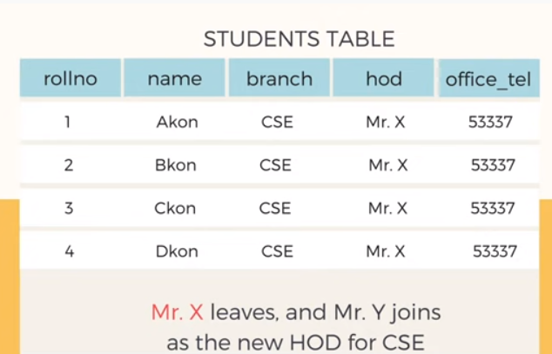
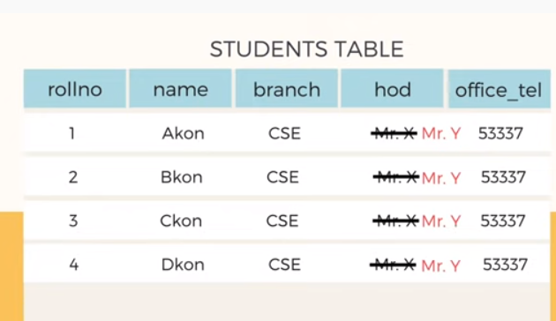
Modify /update anomaly

Slide 9
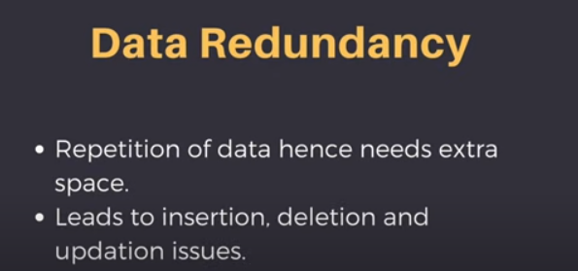

Slide 10

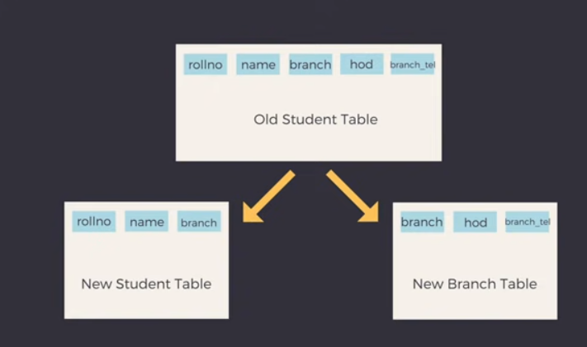
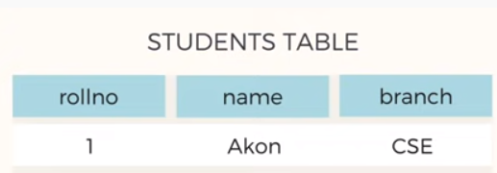
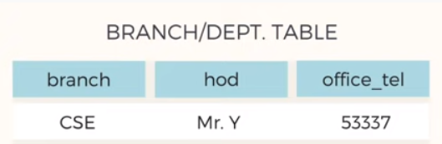
How normalization solve this problem

Slide 11
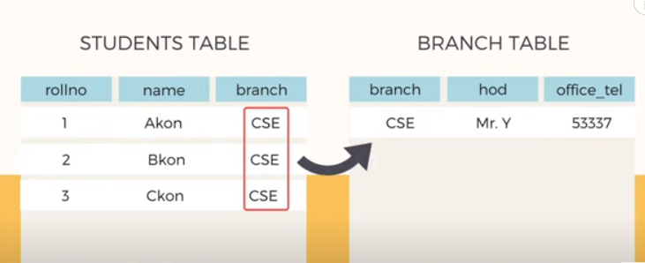
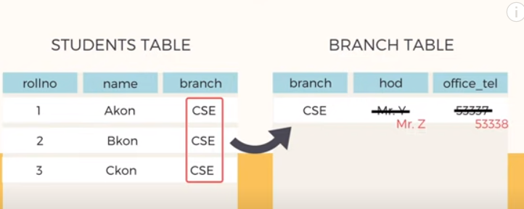

Slide 12
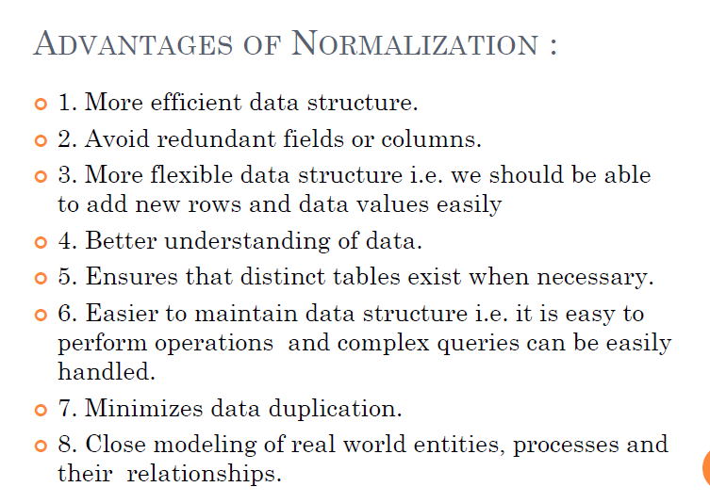

Slide 13
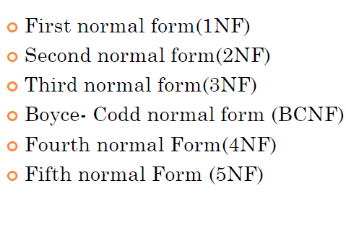
Types of Normalization

Slide 14
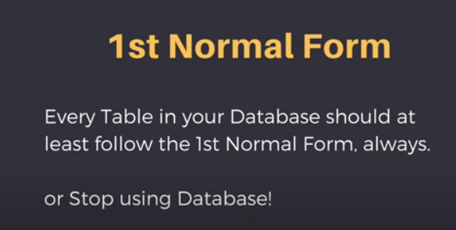

Slide 15
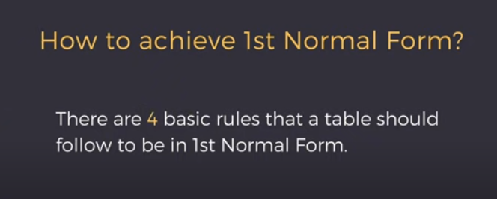
1St Normal Form

Slide 16
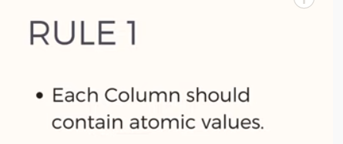
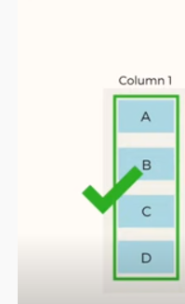

Slide 17
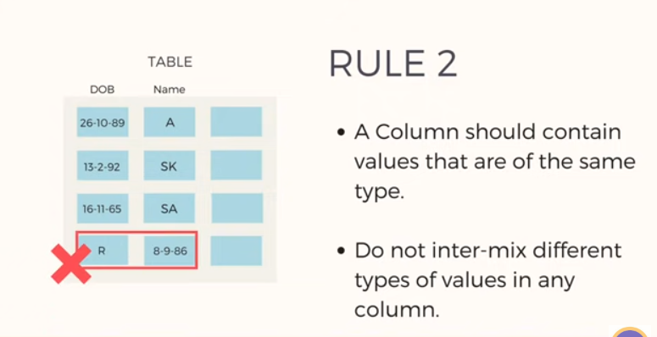

Slide 18
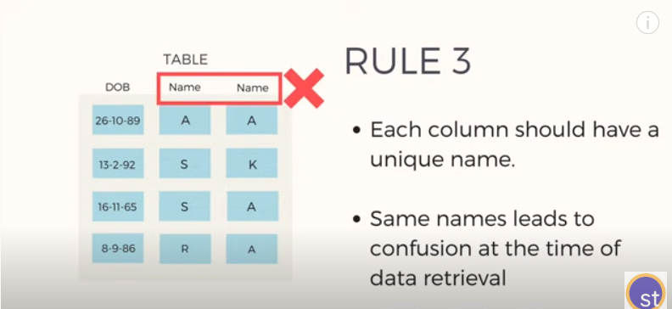
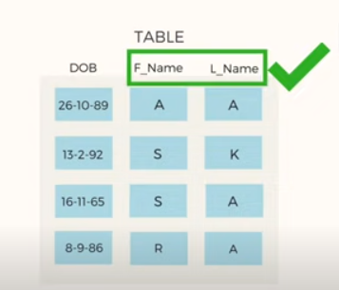

Slide 19
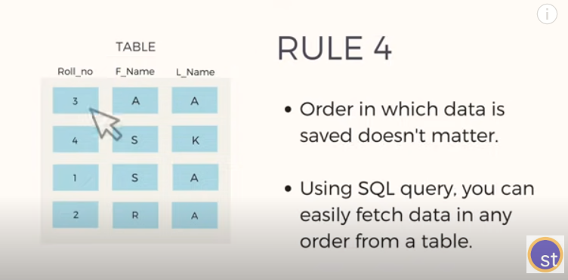

Slide 20
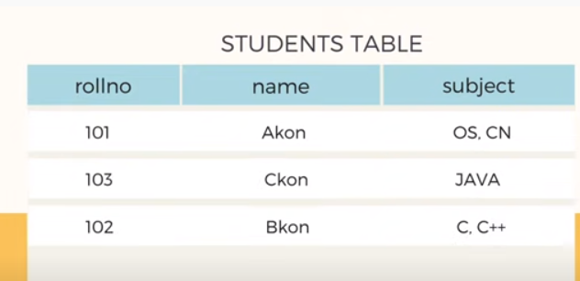
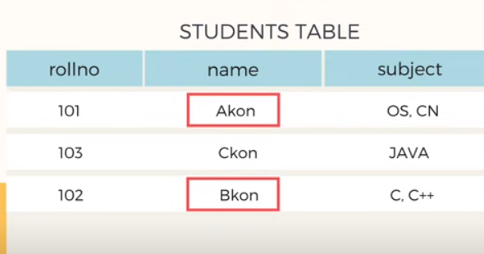
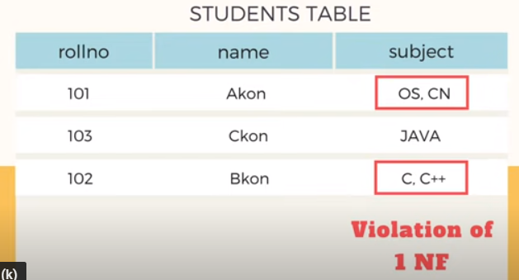
Example of 1NF

Slide 21
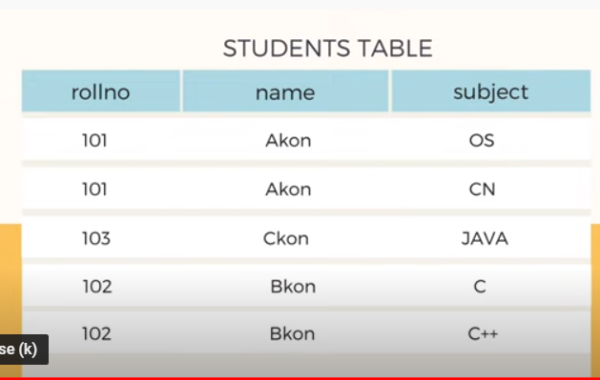
How to solve this :- break the values into atomic values
This is all about first normal form

Slide 22
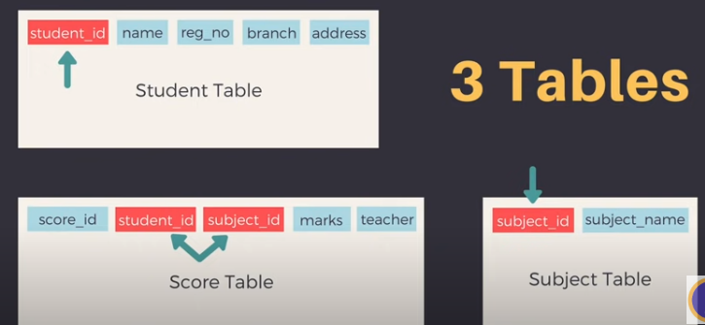
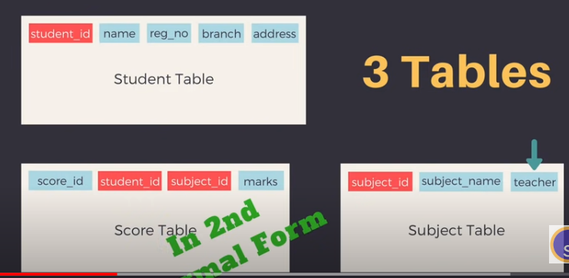
2NF
Here student id ,subject id is a primary key
Score table has teachers name which is only dependent on subject id so we move it to subject table

Slide 23
3NF(transitive Dependency)

Slide 24
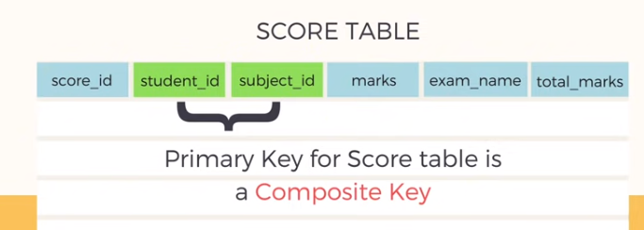



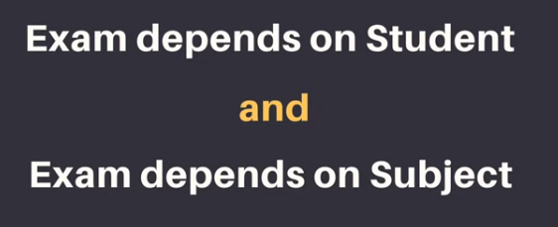


Slide 25

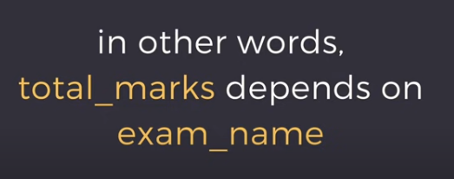
HOW this is

Slide 26
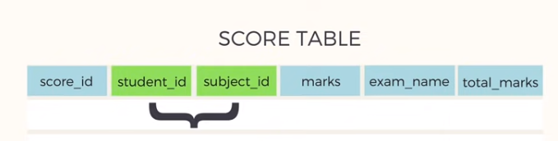
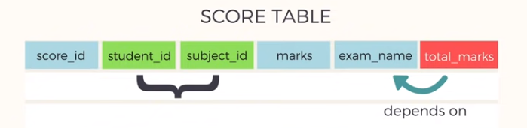
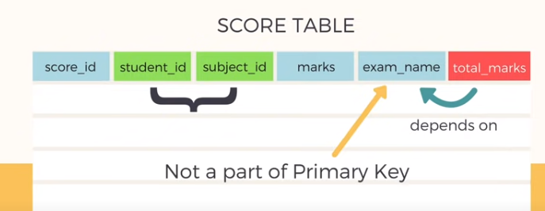
student id +subject id is the primary key ,now you know all other attributes are depend on primary key ,except total marks because total marks depends on exam name attribute.

Slide 27
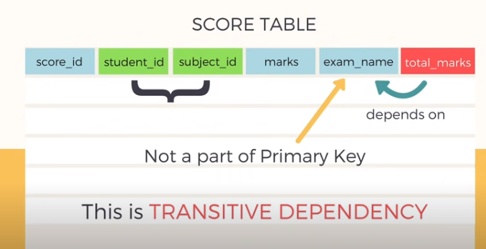
When there is an attribute in a table which depends on some non-primary attributes but not depends upon prime attributes that is called transitive dependency

Slide 28
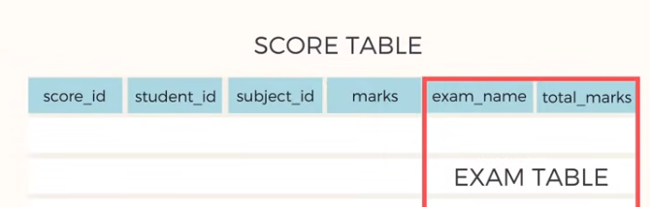
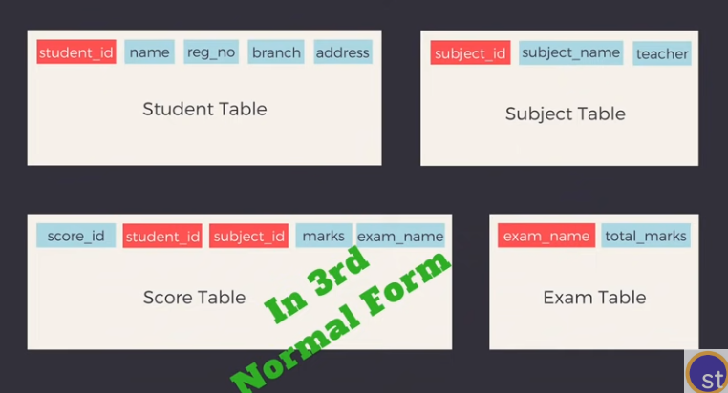
Solution for this is

Slide 29
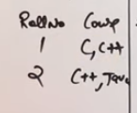
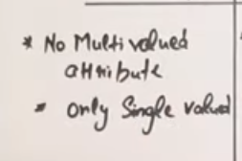
1st Normal Form
For course attribute it consists of 2 values ,which is not allowed so make separate entry for course

Slide 30
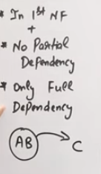
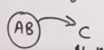
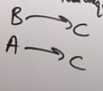
2nd Normal form
It means table should be in 1NF ,there is no partial dependency it means full dependency required.
Example you can see here AB representing C
Means AB is a candidate key which is a unique and it represents to C . And C is non unique
(AB are unique and they are representing to non unique C
Not allowed,this is called partial dependency
This is called full dependency

Slide 31
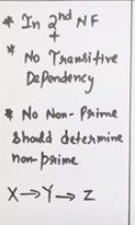
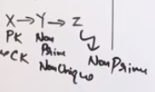
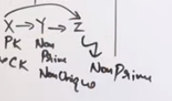
3 Normal form
Here x is primary key /candidate key (unique) which determines to Y where Y is non unique
Here indirectly x determine to z also ,which is called transitive dependency

Slide 32

BCNF(Boycee Codd Normal Form)

Slide 33

4th Normal Form

Slide 34



5th Normal Form
Again whenever you join both tables then there is a problem of extra tuples
To reduce this problem make common attribute as candidate key

